Slide 1
NLTK (Natural Language Processing Tool Kit)
Presented By
Ganti Sunitha

Slide 2
INTRODUCTION
What is Natural Language Processing?
Natural language processing (NLP) is the ability of a computer program to understand human language.

Slide 3
NATURAL LANGUAGE PROCESSING TOOL KIT
NLTK is a open source Python modules and data sets.
This toolkit is one of the most powerful NLP libraries which contains packages to make machines understand human language and reply to it with an appropriate response.
Download NLTK from nltk.org.
pip install nltk
import nltk
nltk.download()

Slide 4
Features Of NLTK
Tokenizing
Stop Words
Stemming
Parts Of Speech Tagging (POS tagging)
Lemmatizing
Corpora
Wordnet

Slide 5
TOKENIZATION
Tokenization is taking a text or set of text and breaking it up into its individual words.
There are two types of tokenizers in NLTK
1. word tokenize
2. sentence tokenize
Word tokenize : A sentence or data is split by space into words.
Sentence tokenize : A data or string is split by . (full stop) into sentences

Slide 6
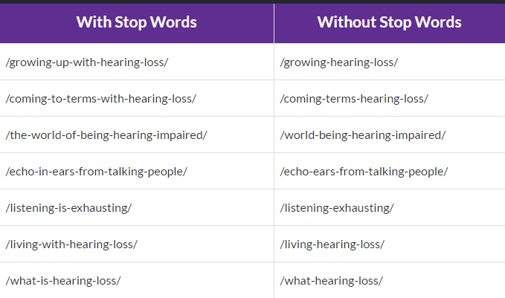
STOPWORDS
NLTK in python has a list of stopwords stored in 16 different languages.

Slide 7
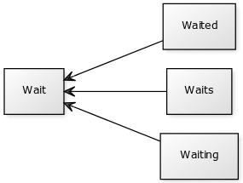
STEMMIING
Stemming is a sort of normalizing method.
Ex: I was taking a ride in the car. I was riding in the car.
The above sentence means the same thing it is not necessary to differentiate between ride and riding.

Slide 8
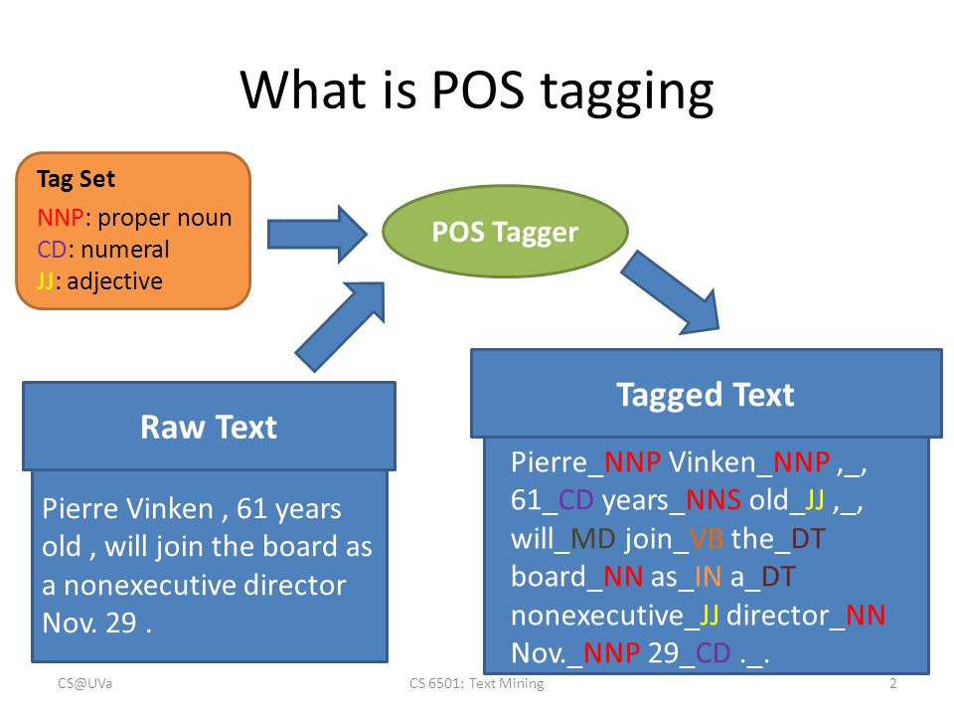
PARTS OF SPEECH TAGGING

Slide 9
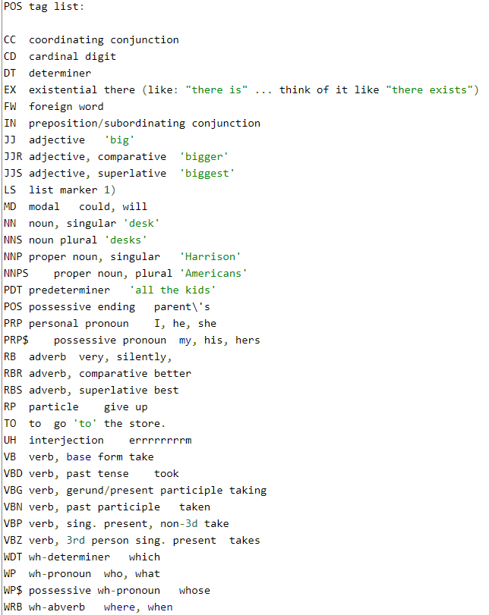
PARTS OF SPEECH TAGGING

Slide 10
LEMMATIZING
Lemmatization, unlike Stemming, reduces the words properly ensuring that the root word belongs to the language.
In Lemmatization root word is called Lemma.
A lemma (plural lemmas) is the dictionary form, of a set of words.
EX:
Text studies studying cries cry am having Stemming studi studi cri cri am hav
Lemmatizing study studying cry cry be have

Slide 11
WORDNET
WordNet is the lexical database i.e. dictionary for the English language.
Synset is a special kind of a simple interface that is present in NLTK to look up words in WordNet.
Example:
from nltk.corpus import wordnet
syn = wordnet.synsets(‘program’)[0]
print ("Synset name : ", syn.name())
# Synset name :plan.n.01
# Defining the word
print ("\nSynset meaning : ", syn.definition())
# Synset meaning : series of steps to be carried out
# list of phrases that use the word in context
print ("\nSynset example : ", syn.examples())
# Synset example : [‘they drew up a six steps plan']

Slide 12
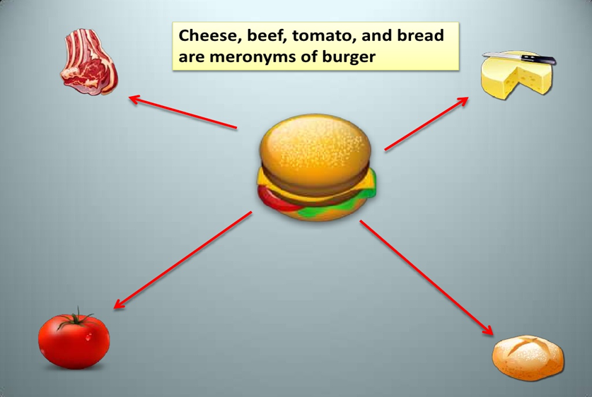
Meronyms
It is a word that denotes a constituent part or a member of something.
For example, apple is a meronym of apple tree (sometimes written as apple<apple tree)

Slide 13
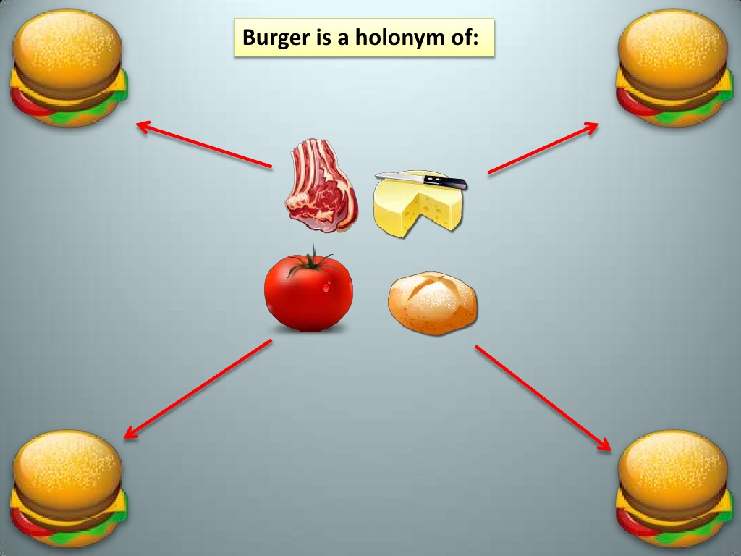
Holonyms
The name of the whole of which the meronym is a part.
Apple tree is a holonym of apple (apple tree>apple). The whole-to-part relationship is called holonymy

Slide 14
CORPORA
The nltk.corpus package contains a collection large set of corpora.
There are more than 60 corpora in different languages.

Slide 15
Classification Algos in NLTK
Naive Bayes
Logistic Regression
Decision Tree

Slide 16
Applications
Sentiment Analysis
Speech Recognition
Text Processing
Search Engine
Advanced Text Editors

Slide 17
THANK YOU

